Slide 1

Machine Learning-Based Real-Time Conveyor Inspection and Performance Improvement for Steel Industries
INDUSTRY PROJECT
20ECSW494
Submitted By
Shreyas Joshi 01FE20BCS145
Under the guidance of
Mrs. Pratibha R Malagatti

Slide 2
Introduction
Video analytics is a rapidly evolving field that leverages artificial intelligence and machine learning to extract valuable insights from video data.
By analyzing video streams in real time, video analytics systems can detect, track, and analyze objects, faces, and activities, enabling a wide range of applications in security, surveillance, retail, and more.
By harnessing the power of machine learning, artificial intelligence, image processing, and video data processing, technologies like OpenCV and YOLO can provide instantaneous analysis directly on the factory floor.
KLE Technological University

Slide 3
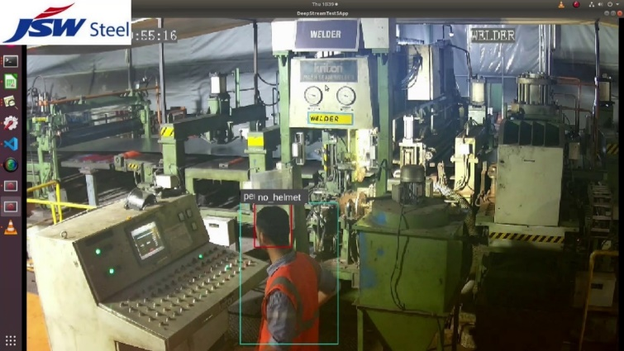
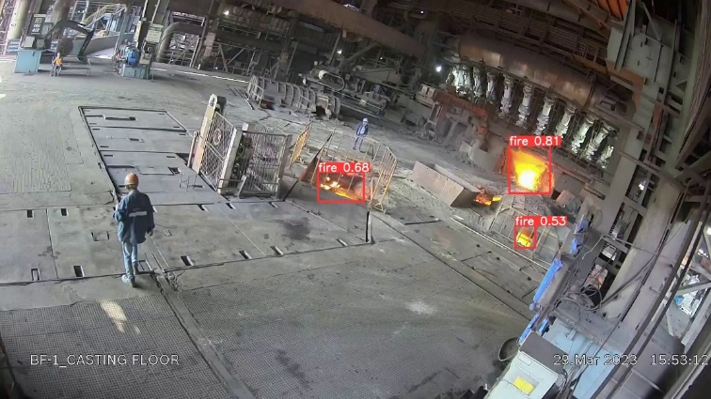
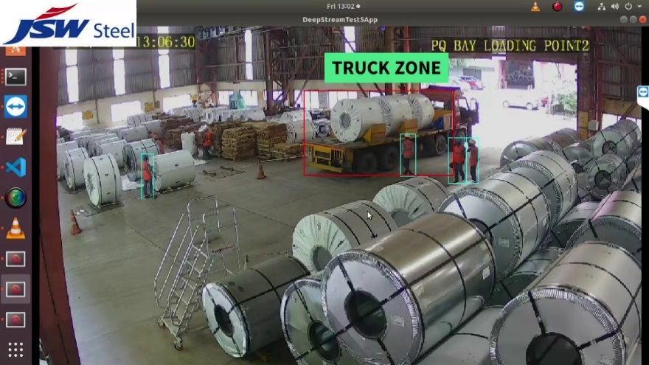
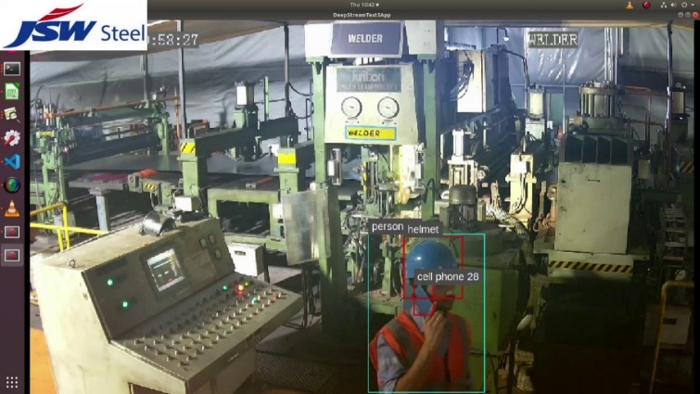
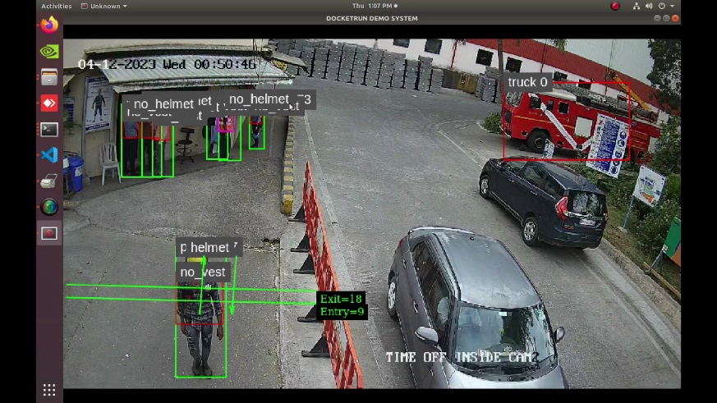
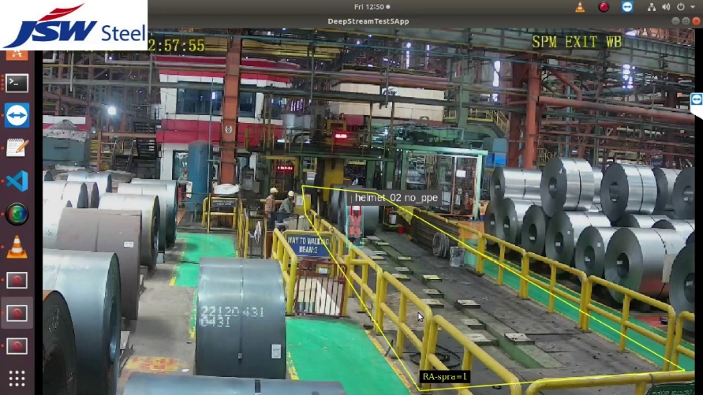
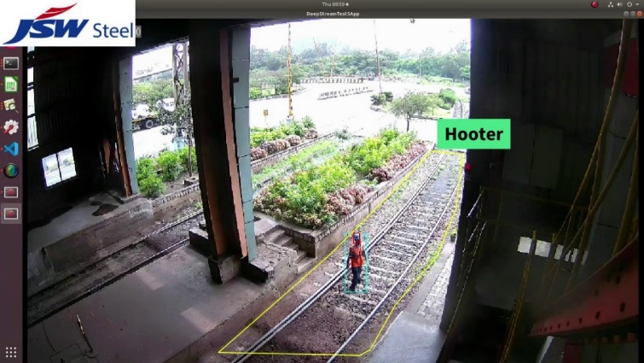
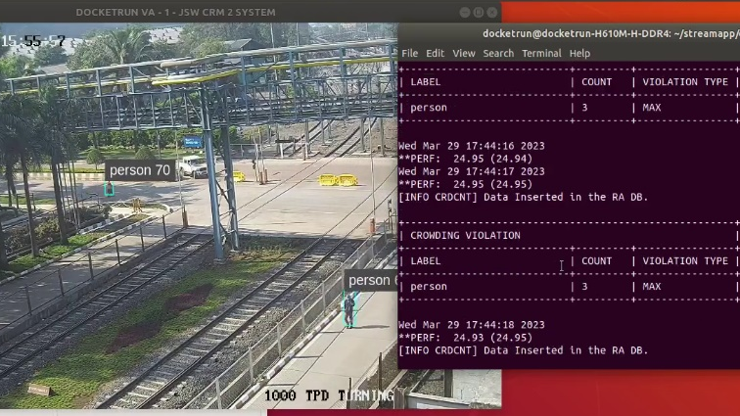
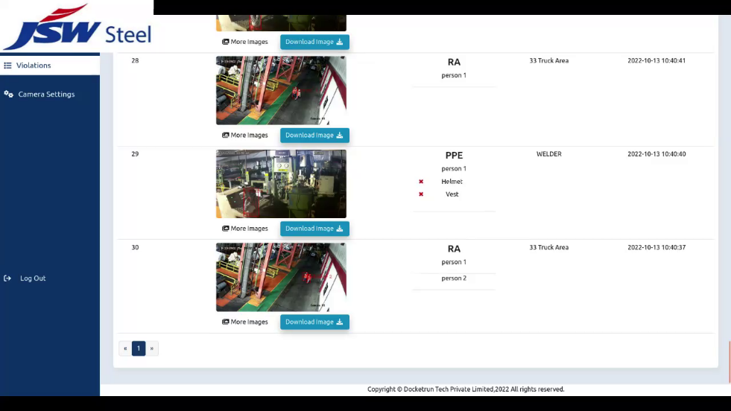
PERSONAL PROTECTIVE EQUIPMENT
FIRE DETECTION
TRUCK REVERSAL ALERT
MOBILE PHONE USAGE
TRAFFIC COUNTING
MAN-MACHINE INTERFACE
GEO-FENCING / RESTRICTED AREA
CROWDING
COMPLETE VIOLATION DASHBOARD
KLE Technological University

Slide 4
Motivation
Downtime Reduction: Real-time analysis enabled by video analytics can anticipate equipment failures, allowing for proactive and immediate response to be carried out minimizing unplanned downtime.
Remote Monitoring: Video analytics enables remote monitoring of operations, allowing for real-time decision-making and management of multiple sites from a central location.
Enhanced Performance: The real-time monitoring and alerting system significantly improves operational efficiency.
Comprehensive Analysis: The system collects and stores violation details in a database, enabling thorough analysis and the ability to draw meaningful inferences.
KLE Technological University

Slide 5
Problem Statement
Develop a comprehensive end-to-end machine learning system for real-time monitoring and inspection of CCTV inputs for conveyor machines to enhance operational performance and ensure workplace safety.
KLE Technological University

Slide 6
Objectives
To create a robust system that continuously monitors conveyor walls, identifying and detecting any deviations from linearity in real time.
To implement a comprehensive monitoring system that accurately identifies and detects missing or misaligned cleats on the conveyor belt in real time.
To design an automated alert system that triggers notifications to relevant personnel whenever a violation is detected, ensuring prompt response and action.
To implement a reliable logging mechanism that continuously records details of all detected violations, securely storing this information for future analysis and reference.
KLE Technological University

Slide 7
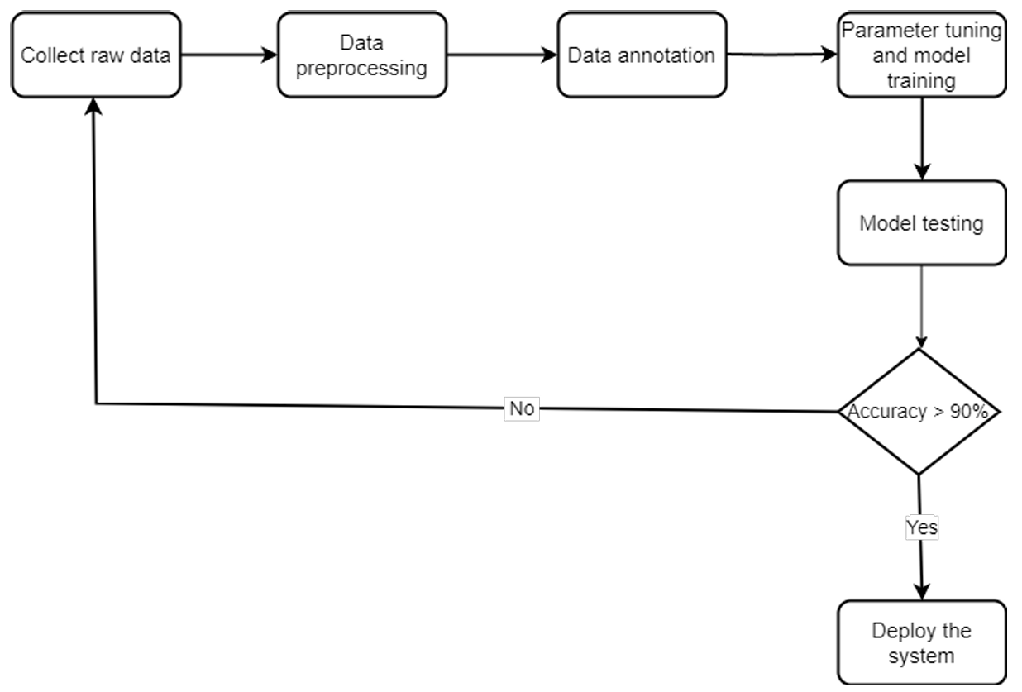
System Model
Figure 1: System model for conveyor detection
KLE Technological University

Slide 8
Functional Requirement
User shall be able to provide video or live feed as input.
User shall be able to modify the position of reference lines.
User shall be able to monitor missing cleats or unaligned cleats, non linear walls.
User shall be able to modify the details that are stored in database.
User shall be able to receive an excel sheet containing violation details.
User shall receive alert notification through email and whatsapp.
KLE Technological University

Slide 9
Non-Functional Requirement
Performance: The system should process video frames with minimal latency, aiming for real-time performance.
Usability: The user interface should be intuitive and easy to use for monitoring.
Scalability: It should be designed to easily add new object detection models or integrate with other AI/ML component and work for multiple cameras.
Maintainability: The code should be well-structured and documented to facilitate future mainte nance and updates.
KLE Technological University

Slide 10
Module1: Missing cleats detection
No of videos: 85
Total size: > 25 GB
NO of images: Train: 1481
Val: 272
Test: 450
Model: YOLO V8
No of epochs: 46
KLE Technological University

Slide 11
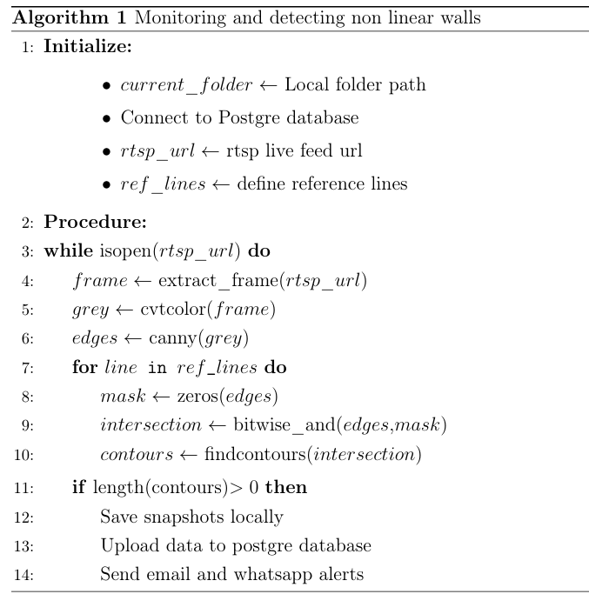
Module2: Non linear walls detection
KLE Technological University

Slide 12
Module3: Real-time Notifications via Email and WhatsApp
A dedicated python program automates the monitoring and reporting of missing cleats in a conveyor system by providing email alerts.
It then creates an Excel file with details of the missing cleats, including the image of the violation and the date and time of detection.
Email notification is sent to the specified recipients (including a CC list) with the Excel file attached, containing a predefined message explaining the nature of the report and the actions needed at 6 AM, 2PM and 6PM everyday.
Similarly the violation details are provided through WhatsApp whenever vioalation is detected enabling immediate attention to the situation.
KLE Technological University

Slide 13
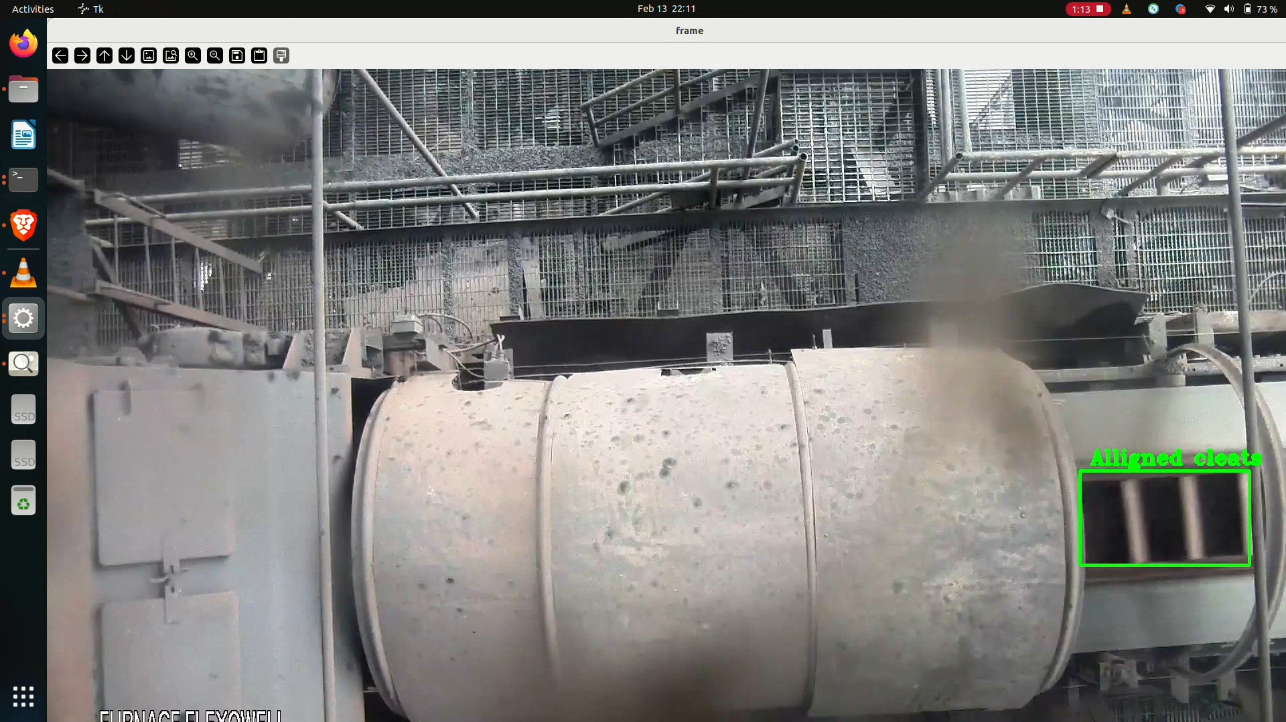
Results
Figure 2: Detection of aligned cleats
KLE Technological University

Slide 14
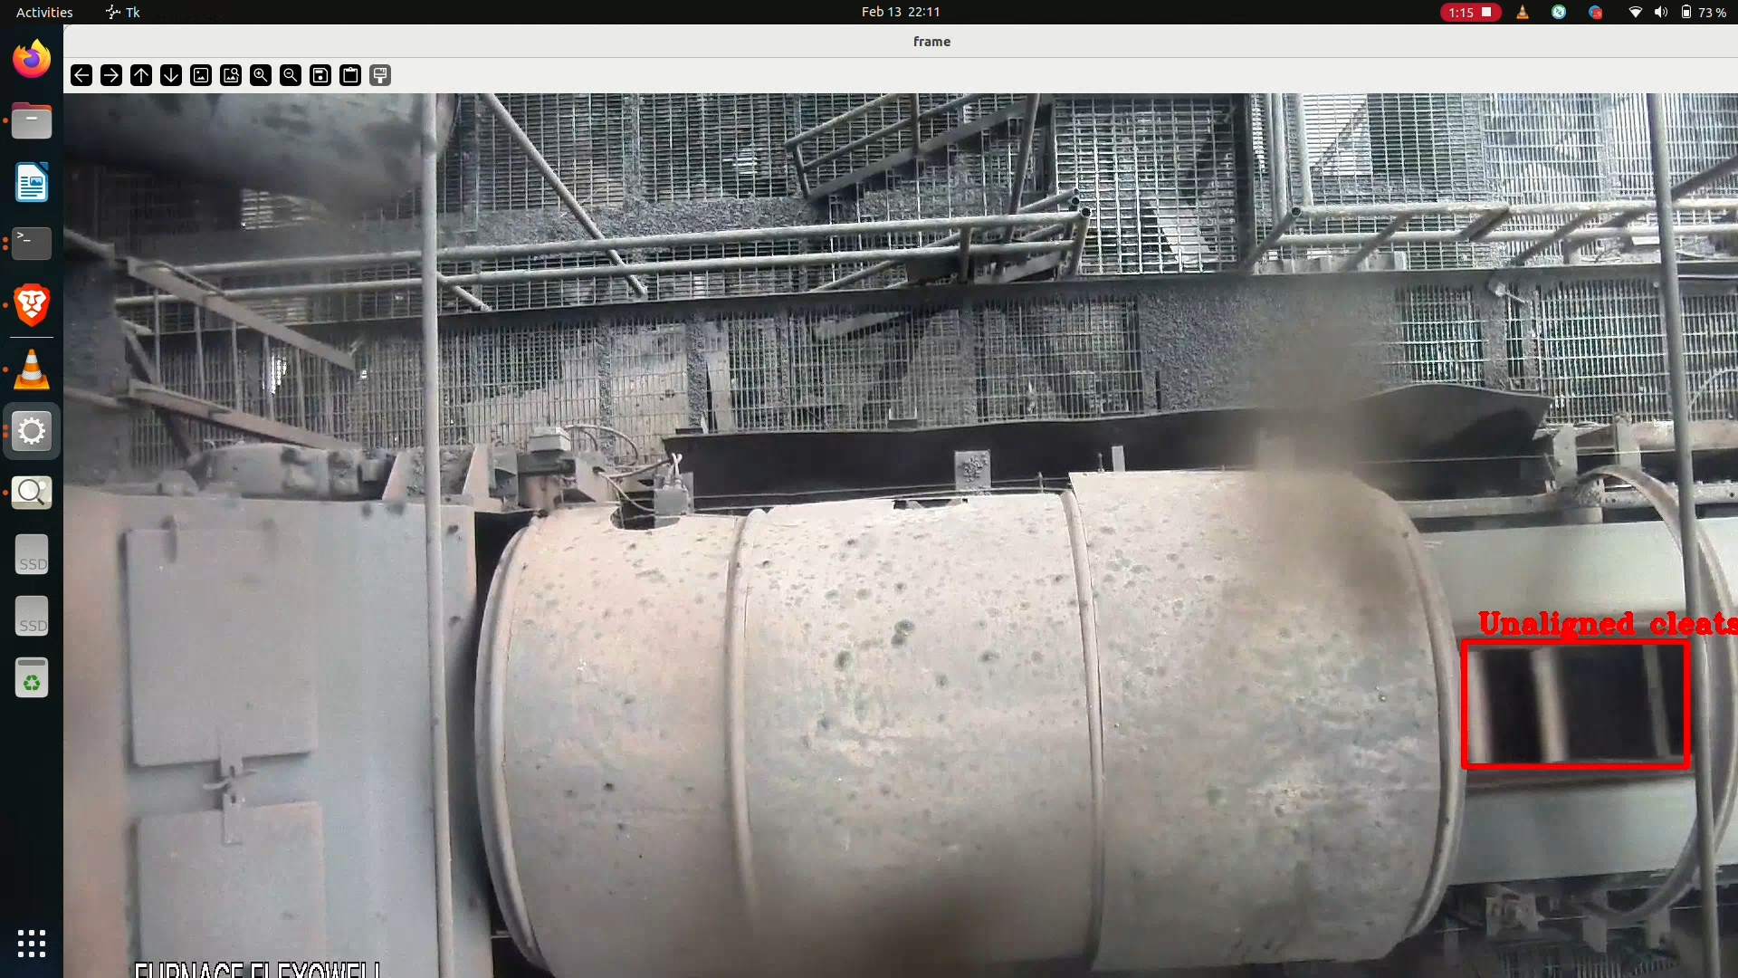
Results
Figure 3: Detection of missing/unaligned cleats
KLE Technological University

Slide 15
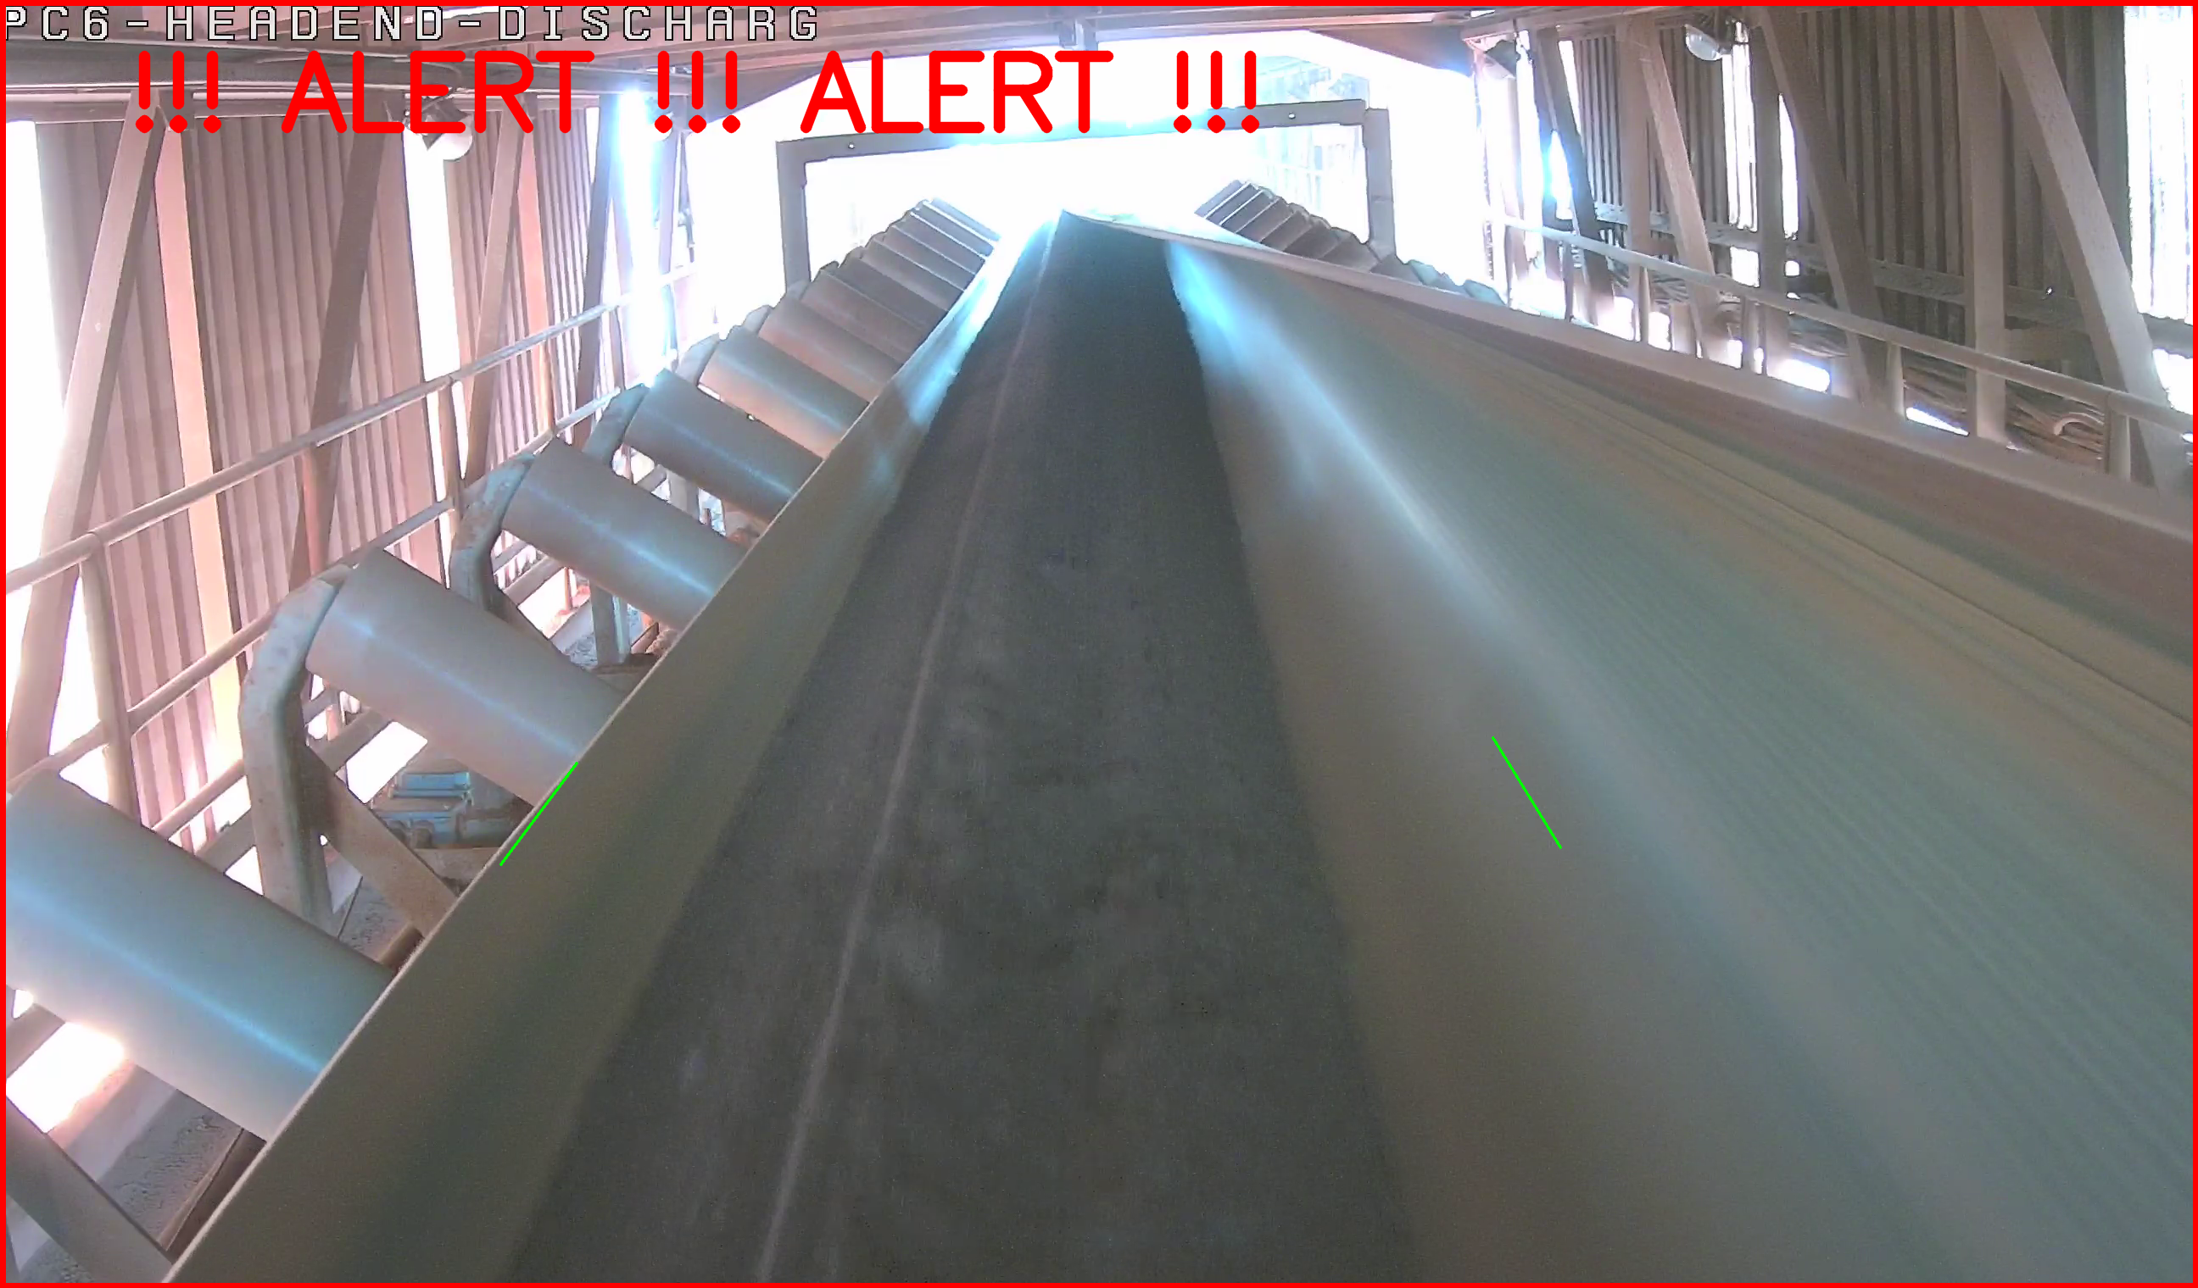
Results
Figure 4: Detection of sheet roll over
KLE Technological University

Slide 16
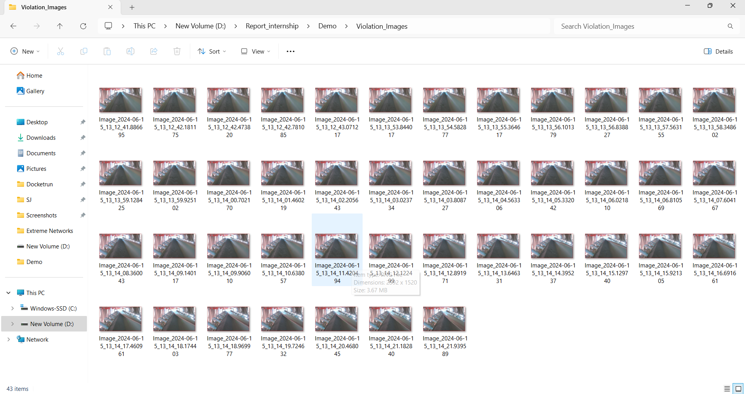
Results
Figure 5: Violation data stored locally on system
KLE Technological University

Slide 17
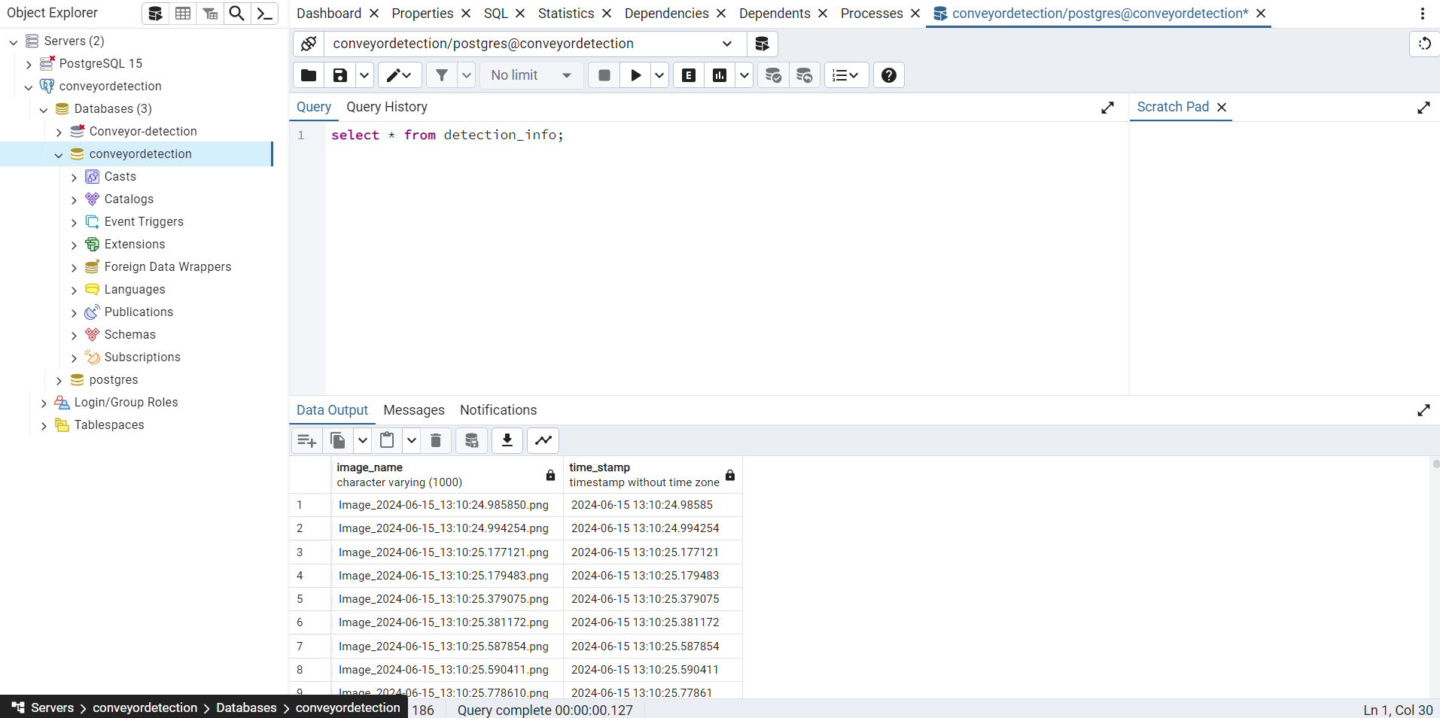
Results
Figure 6: Violation details stored in database for future reference
KLE Technological University

Slide 18
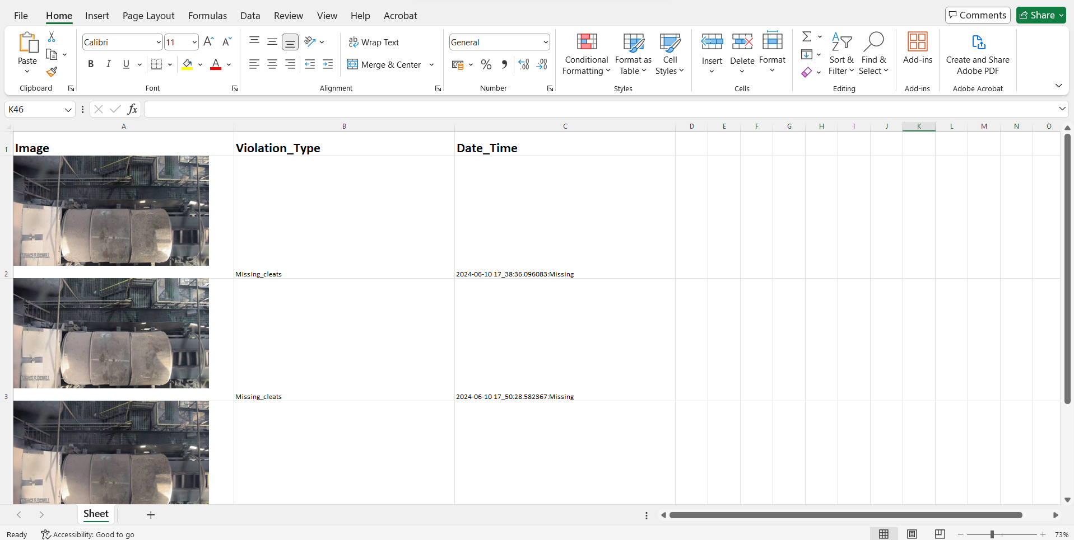
Results
Figure 7: Excel sheet gathering violation details to be send
KLE Technological University

Slide 19
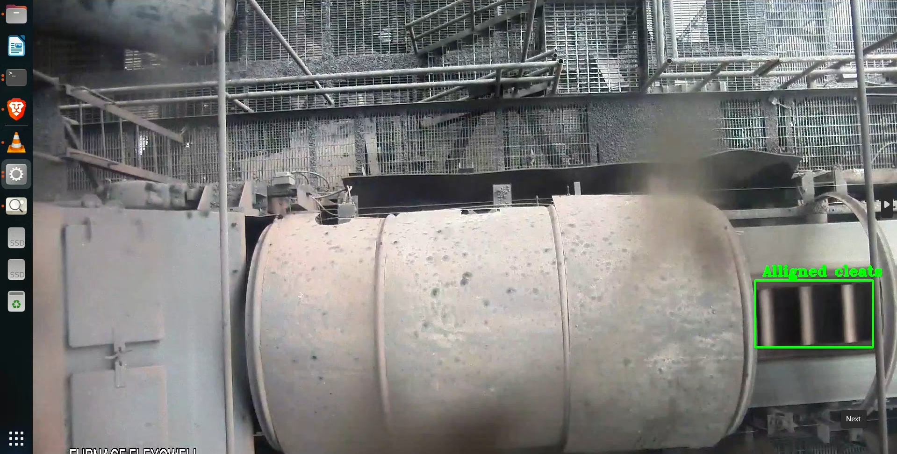
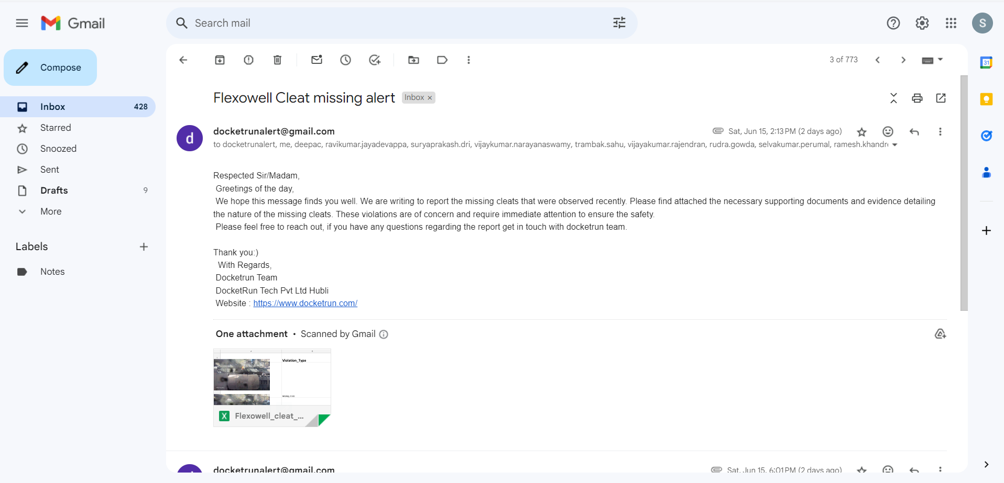
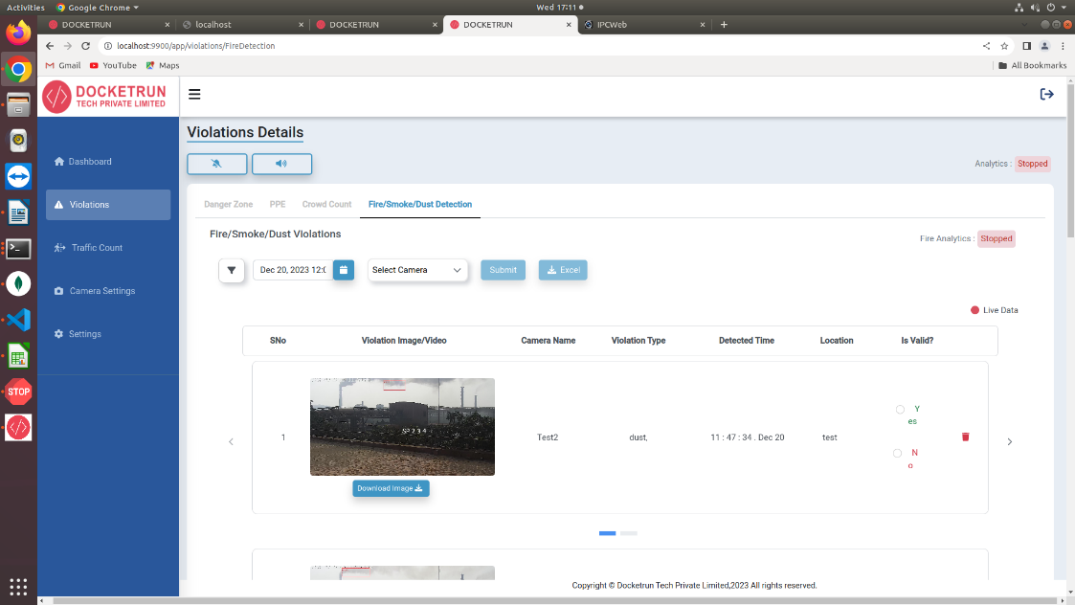
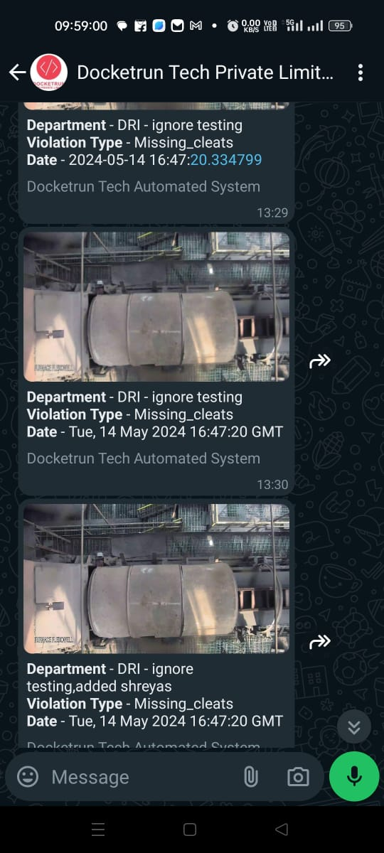
Results
Realtime Conveyor Monitoring & Analytics
Email alerts
Dashboard
WhatsApp alerts
KLE Technological University

Slide 20
THANK YOU!

